Slide 1
CYCLISTIC’S ANALYSIS
Analytics for CYCLISTIC
(Project done on Tableau)

Slide 2
OBJECTIVE
The director of marketing believes the company’s future success depends on maximizing the number of annual memberships. Therefore, the team wants to understand how casual riders and annual members use Cyclistic bikes differently. From these insights, we will design a new marketing strategy to convert casual riders into annual members.

Slide 3
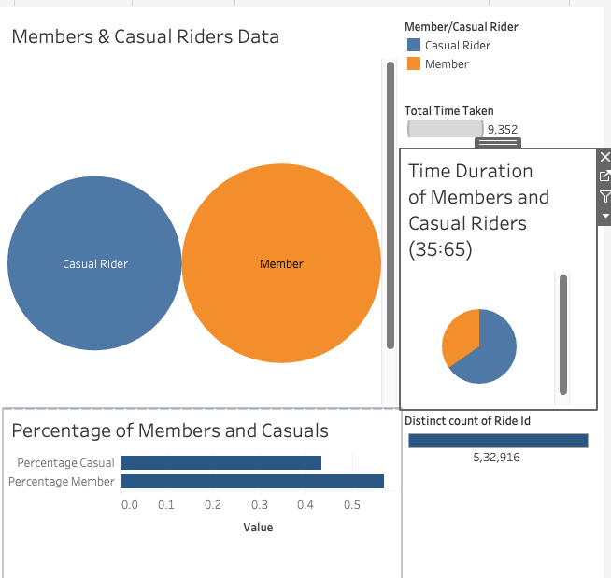
Members & Casual Riders’ Data
This is a visualization of Members vs Casual Riders’ data.
Here, we can see that the number of members are more than that of Casual Riders, which is a god sign for us.
However, there is a very interesting graphic on the right of the Visual. It shows that Time duration of Bikes used by Casual Users are much more than Members. So, is this because our Members don’t use this much, and the Casual Riders use it a lot? Let’s Examine…

Slide 4
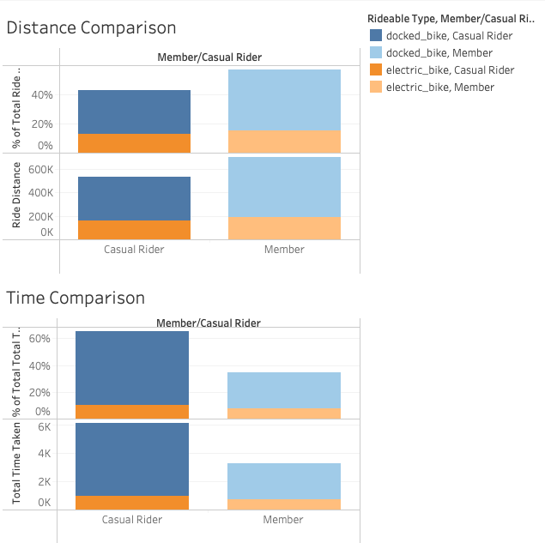
Distance and Time Comparison Data
Here, we can get the Answer for the previous question from the Visual. We can see here that the Distance covered by the Members are more than Casual Users, even though the Time of usage by Casual Riders is a lot more. From this we can understand that Casual riders are taking it out for Leisure where they may go for touristic visits, or picnics, or even Camping at night due to which the Time goes up. However, Members are using it more for their daily commute and their busy daily schedules due to which they ride to their destination and come back rather than spending leisure time there. So, we can understand that it is not because most Casual Riders don’t know about the Membership plan, but they just don’t require it since they use it once a while.
So, if we want to Maximize the Annual Membership by Forcing more Casual Users to take up Membership, what we can do is Increase the Cost per Unit Time, Keeping the Cost per Unit Distance pretty much Constant. Or to the already existing Plan, add/Increase Time Constraints.

Slide 5
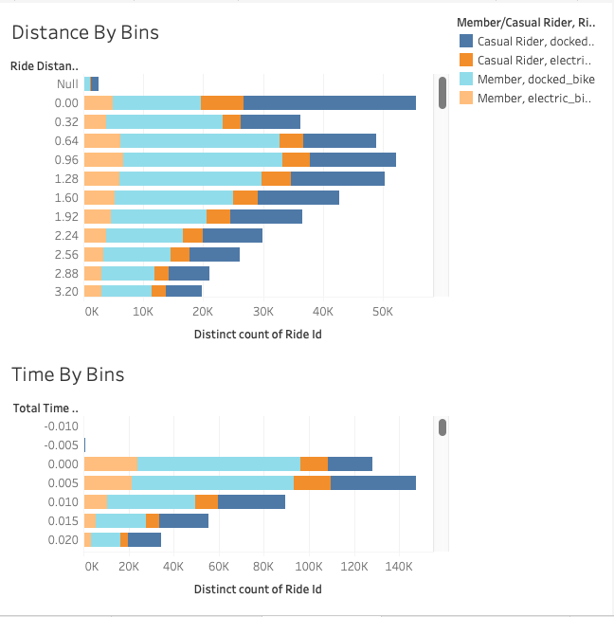
Distance By Bin Height
This Visual Helps us understand the 4 different categories by the distance they traveled.

Slide 6
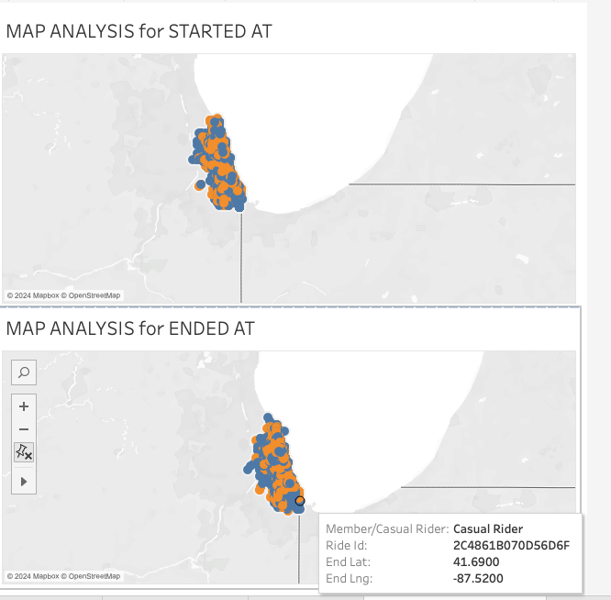
Map Analysis for Started At And Ended At
This shows the Map for Members (Orange), and
Casual Riders (Blue).
First Visual is Started At, and Second is Ended At.
Here, we can say that the Casual Riders (Blue) is showing a Higher Spread than the Members (Orange), though it is not very clear from the Visual.

Slide 7
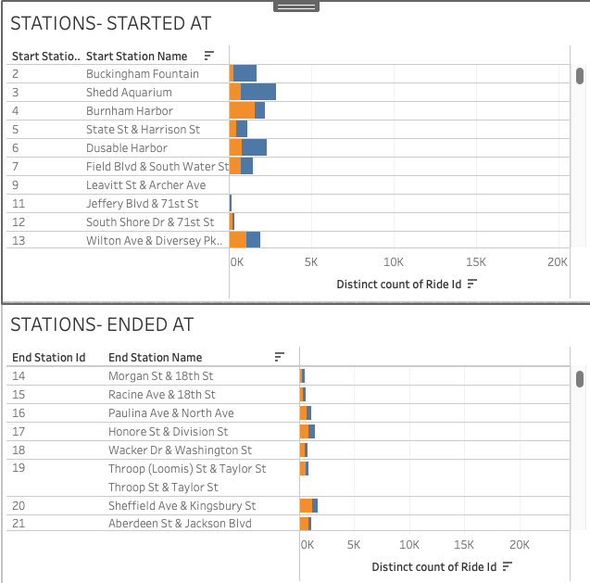
Popular Stations for Started At and Ended At

Slide 8
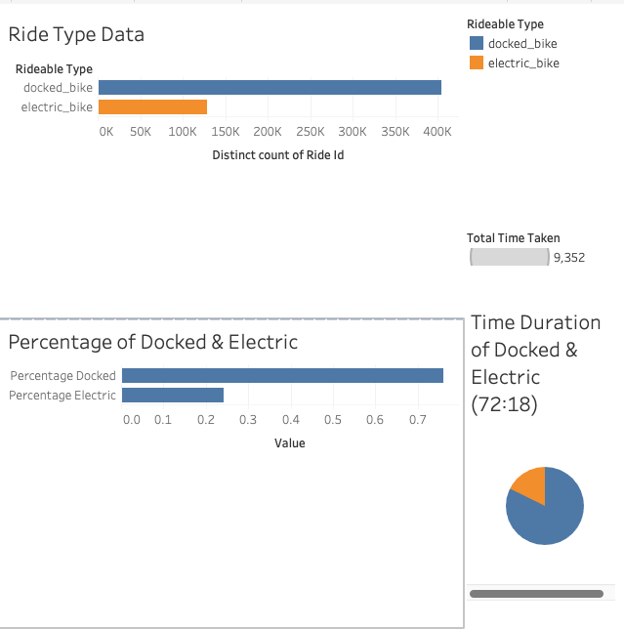
Rideable Type- Docked And Electric Data
This Visual Shows the Difference between the 2
Modes- Docked Bikes, and Electric Bikes.
We can see here that Docked Bikes are more
In use than the Electric Bikes.
The reason for this is not very clear as of now.
But, let’s try to understand something from the
Maps.

Slide 9
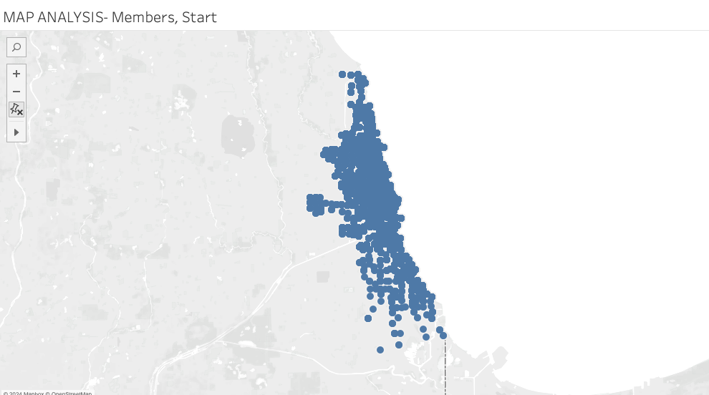
Map Analysis (Members, Started At, & Docked)

Slide 10
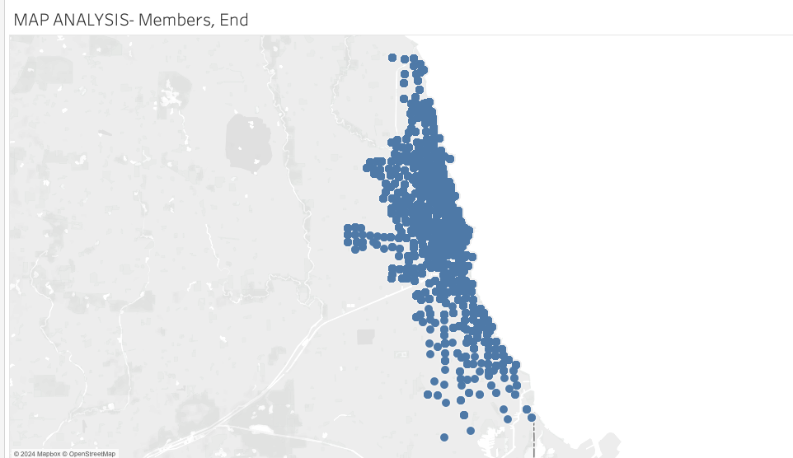
Map Analysis (Members, Ended At, & Docked)

Slide 11
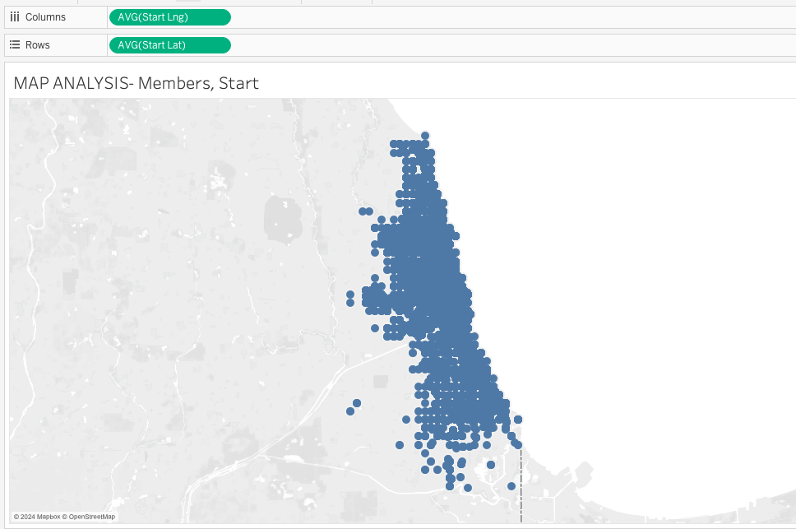
Map Analysis (Members, Started At, & Electric)

Slide 12
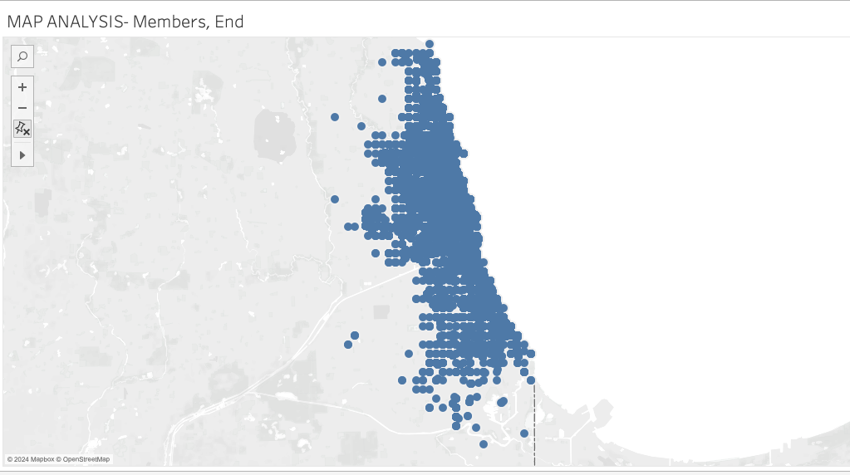
Map Analysis (Members, Ended At, & Electric)

Slide 13
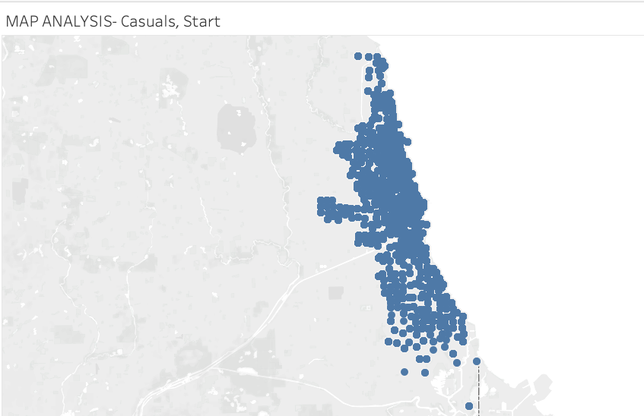
Map Analysis (Casuals, Started At, & Docked)

Slide 14
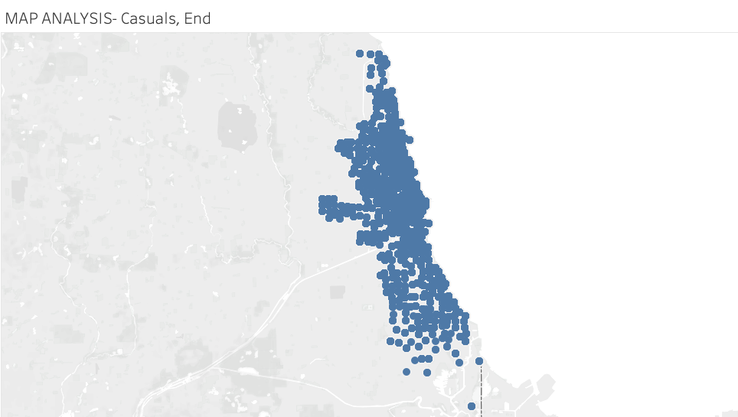
Map Analysis (Casuals, Ended At, & Docked)

Slide 15
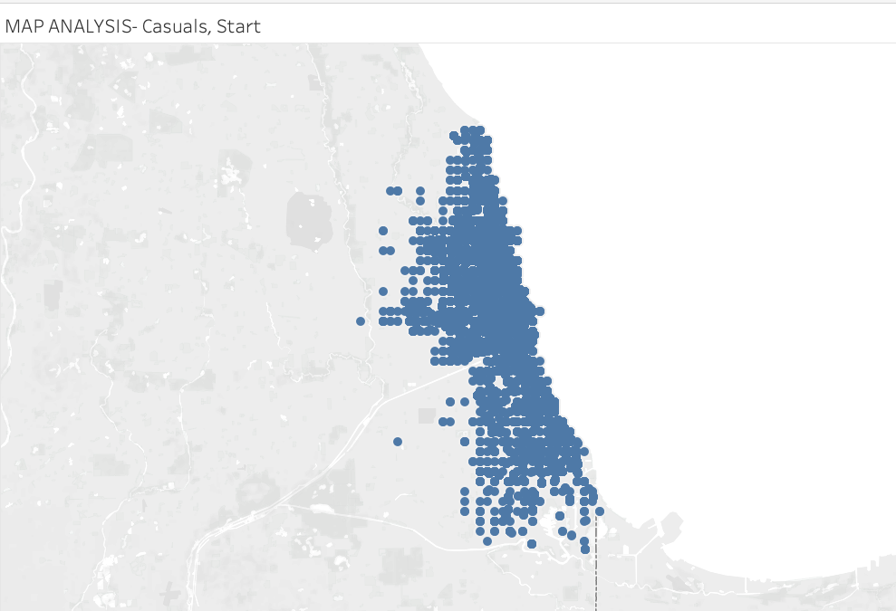
Map Analysis (Casuals, Started At, & Electric)

Slide 16
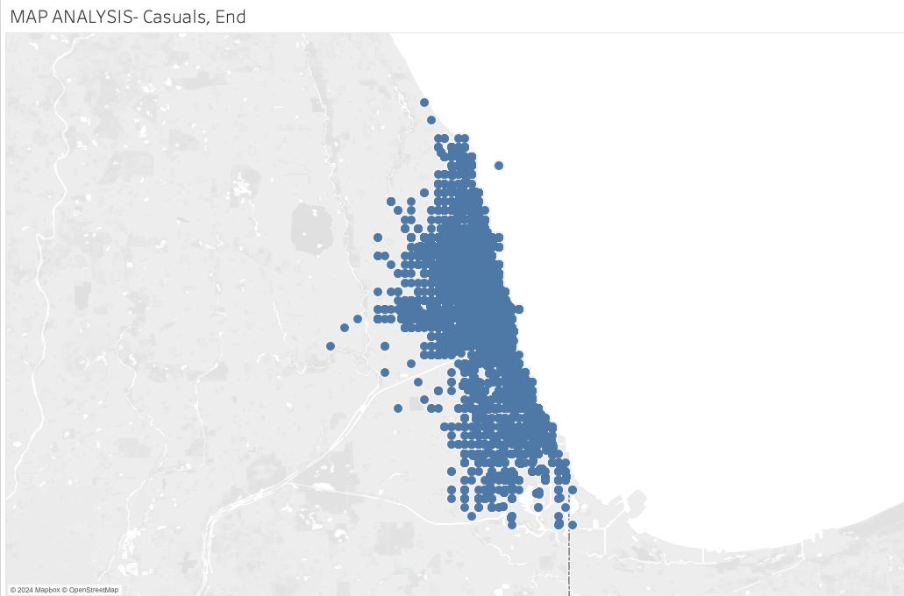
Map Analysis (Casuals, Ended At, & Electric)

Slide 17
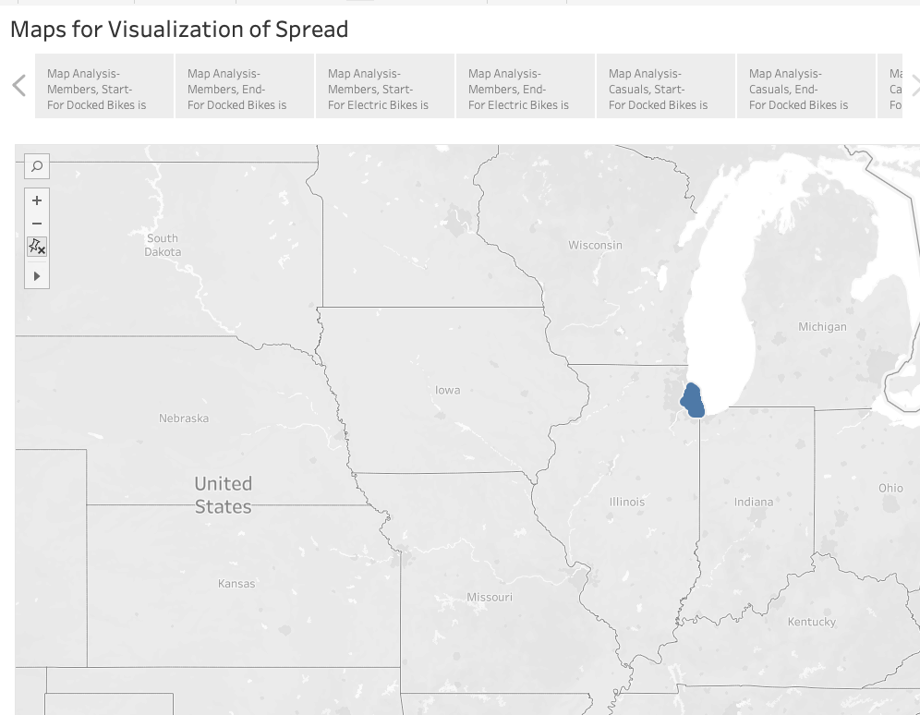
Map Visualization

Slide 18
Reason for Docked Bikes Usage
Though it is not very clear, we see that the Spread for Electric Bikes is Lower. So, maybe the Electric Bikes aren’t available at all Docking Stations.
This is the only possible Assumption from the available dataset.
Since most people usually prefer Electric Bikes, maybe we must invest more into Electric Bikes, with Only Manual Riding option for people who prefer Docked Type for better exercise. I feel Electric Bikes with incorporated extra feature such as those are a better idea than having both electric, and docked bikes.
Membership may also see a Spike if we incorporate such methods.

Slide 19
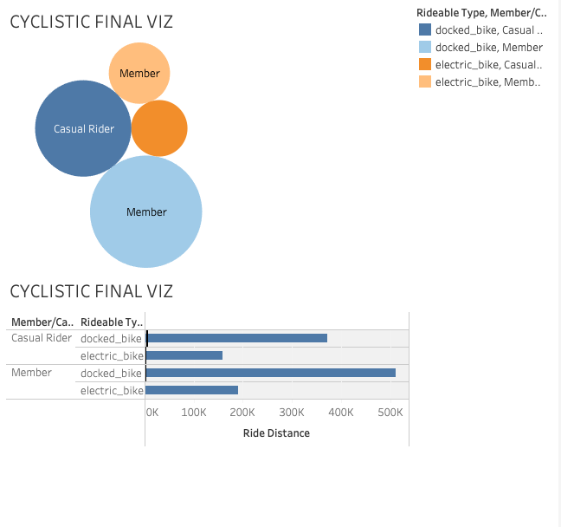
Summary Dashboard

Slide 20
RECOMMENDATIONS…
So, if we want to Maximize the Annual Membership by Forcing more Casual Users to take up Membership, what we can do is Increase the Cost per Unit Time, Keeping the Cost per Unit Distance pretty much Constant. Or to the already existing Plan, add/Increase Time Constraints.
Since most people usually prefer Electric Bikes, maybe we must invest more into Electric Bikes, with Only Manual Riding option for people who prefer Docked Type for better exercise. I feel Electric Bikes with incorporated extra feature such as those are a better idea than having both electric, and docked bikes.

